Slide 2
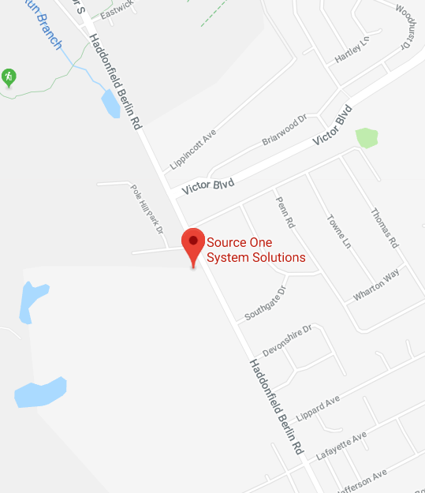
Local & Customized Service
Based in Voorhees, NJ, we serve South Jersey and Philadelphia.
Onsite Consultation & Service
Remote Helpdesk & Support
24/7 Emergency Assistance
Fast Responding
Contact a person, not a call center.

Slide 3
We Guide You Through Change
Professional
Customized
Local
For over 20 years we have been serving the tri-state area by helping them reach their IT needs. We strive every day to live out our mission, which is to give a more personal touch to IT solutions. Many of our clients have commended us for helping to guide them through change and communicating with them regularly.
No two companies have the same IT needs. We will sit with you, learn about your company and suggest ideas to implement in order to help you secure your data with anti-virus software, connect all of your employees through Microsoft 365, improve system connectivity with stronger hardware and wiring, and more.
When something goes wrong with your systems you do not need to call a call center, you need to call a person that will come out on site and fix the problem. Our account managers are our IT technicians, when you call them you are calling their cell phone.

Slide 4
Customer Testimonial
“Thank you for the IT work that you did for our firm during my tenure as Office Administrator. I appreciated not just your expertise in the field but your ability to quickly respond to my calls for help. Businesses today cannot survive without technology. I always had total confidence that you and Source One could keep us up and running and on top of the latest software that could keep the firm up to date in our field. I have often recommended Source One to other administrators and will continue to do so in the future.”
Kulzer & DiPadova, P.A.

Slide 5
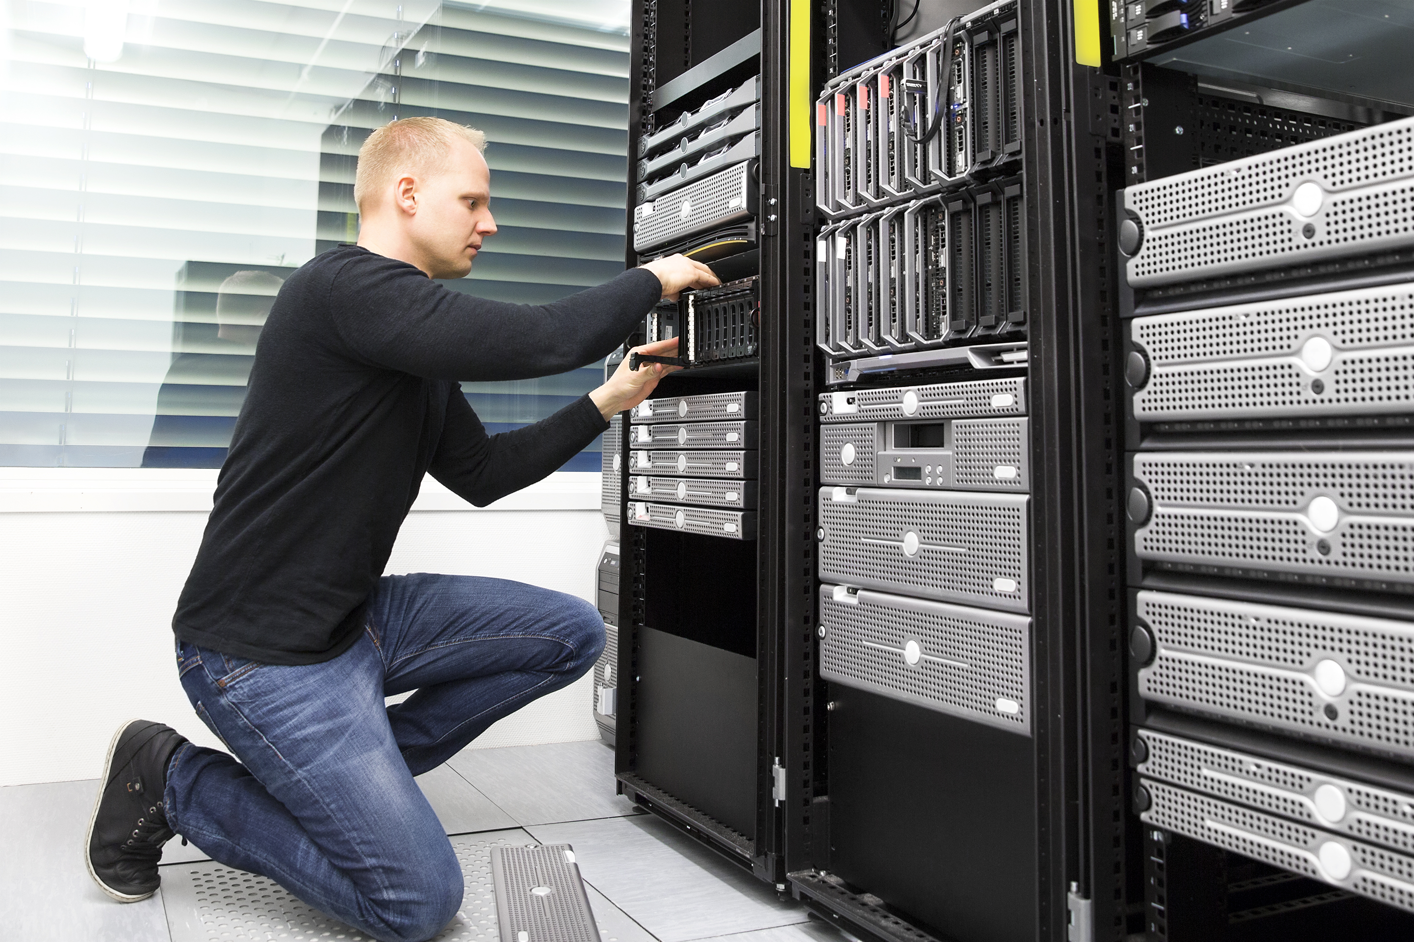
Network Management
Servers
User Workstations-Endpoints
Mobile Device Access
Software Deployment & Upgrades
Security
Policy Enforcement
Auditing
Threat Prevention & Remediation

Slide 6
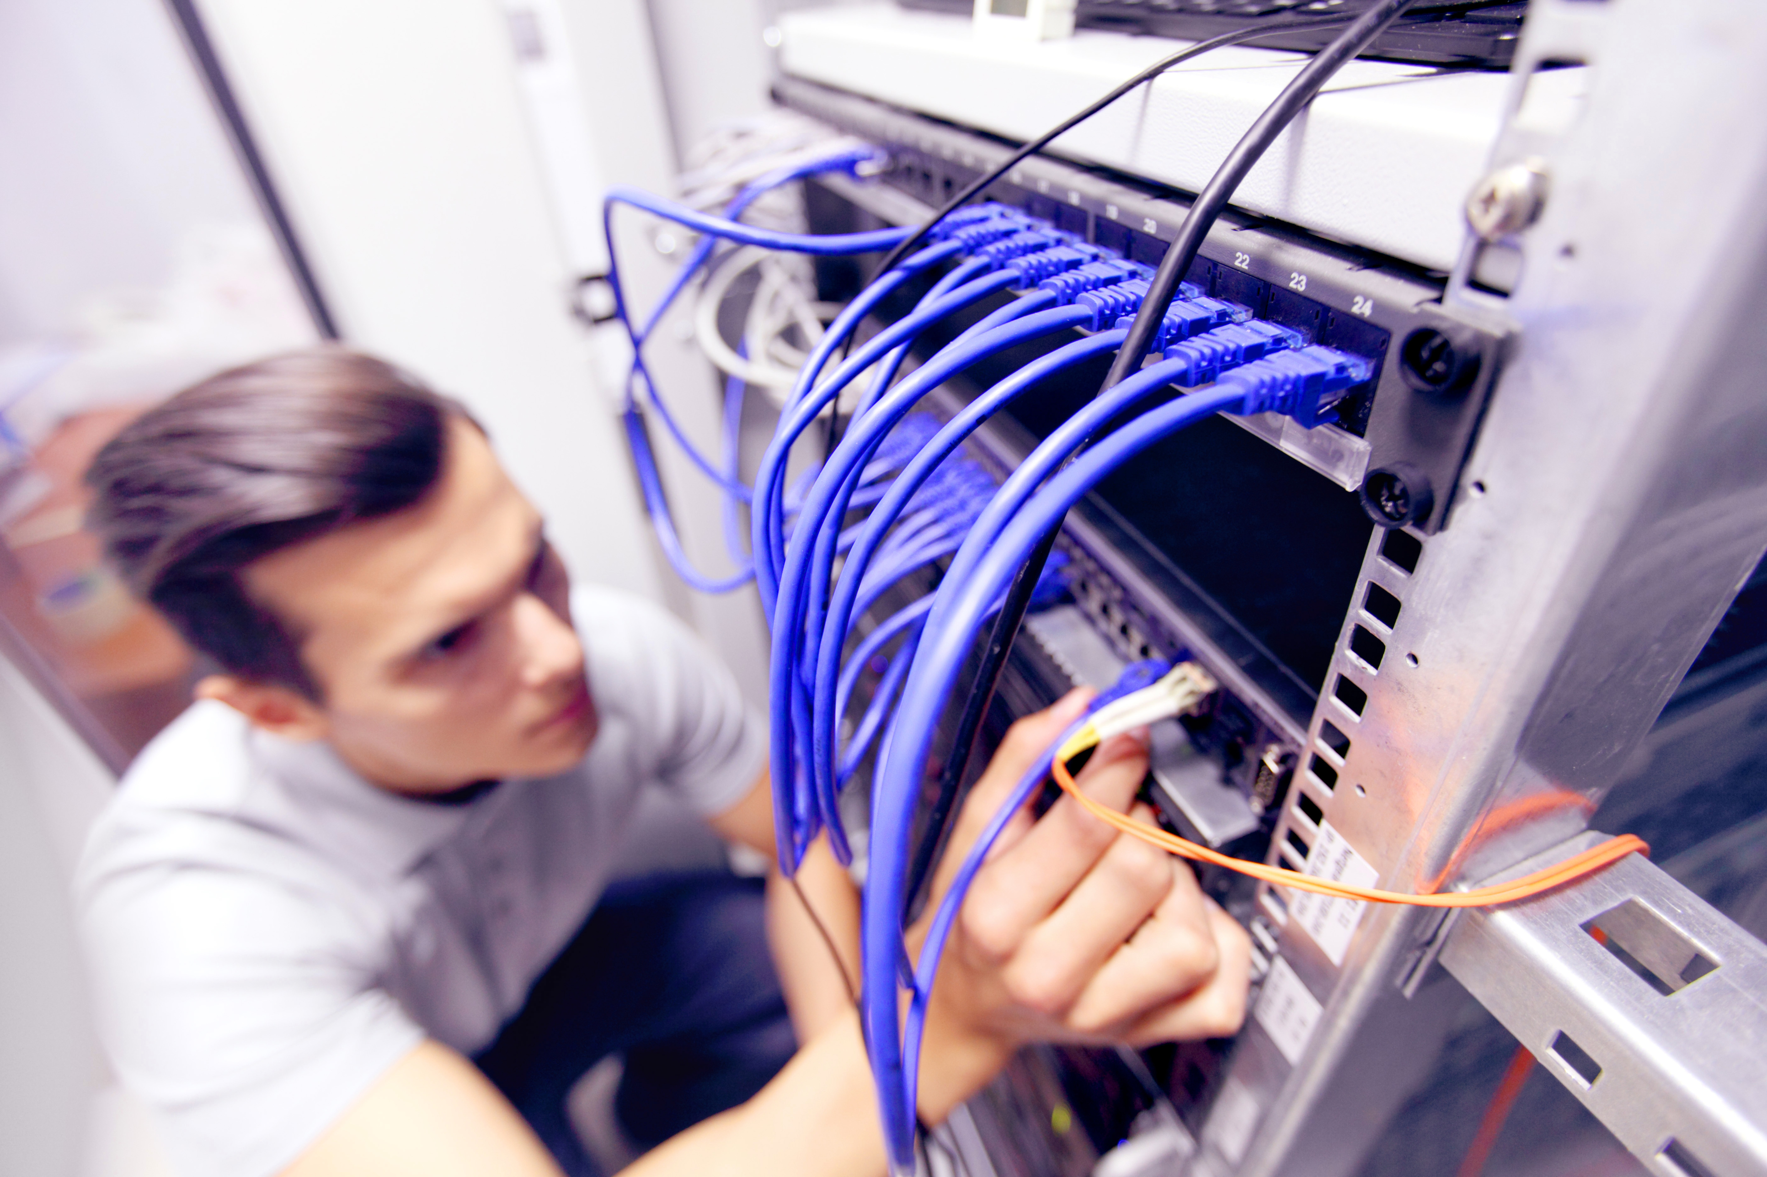

Slide 7
Customer Testimonial
“It is with extreme pleasure that I recommend Source One for all of your outsourced IT needs. The Protocall Group has worked with Source One for over 15 years. Source One has always provided a proactive partnership. We count on their extremely competent staff to provide 24 hour support and they have never failed us.
Source One is a true business partner and I consider their company a welcome extension of our business. Their employees feel like a part of our organization.”
Nancy Tvarok
The Protocall Group

Slide 8
Hosted Services
Get all of your hosted services under
one roof!
Websites & Domain Name Management
E-Mail
Web Based File-Document Storage & Collaboration
Voice over IP (VoIP) Phone Services
Infrastructure and Software as a Service (IaaS / SaaS) Support and Implementation

Slide 9
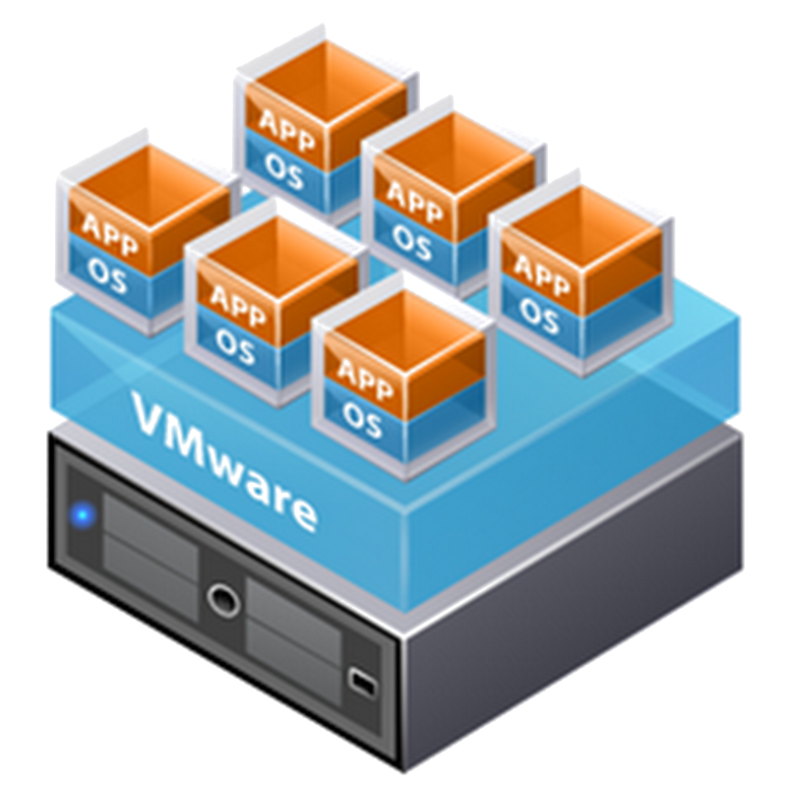
Virtualization Services
Consolidate Your Physical Servers
One Physical Server = Multiple Virtual Servers
Achieve Flexibility
Add, Upgrade, Migrate, or Remove you Virtual Servers with ease
Easily enforce multiple backup topologies

Slide 10
Customer Testimonial
“From the work you are doing to your response time, you have seamlessly incorporated yourself into our business. Response time is very important to us and it is refreshing to work with a company that has a similar mindset. Thank you for all of the work that you do for us.
You consistently meet all of our IT needs and take care of any issues that may arise. All in all, we highly recommend Source One to other companies for IT consulting.”
Janet Eisiminger – Regional Nephrology Associates

Slide 11
Disaster Recovery
Don’t lose all of your and your
customer’s information! Use us for
data security!
Offsite Backup Storage & Replication
Multi-Tiered Backups
Daily
Nightly
Monthly-Quarterly

Slide 12
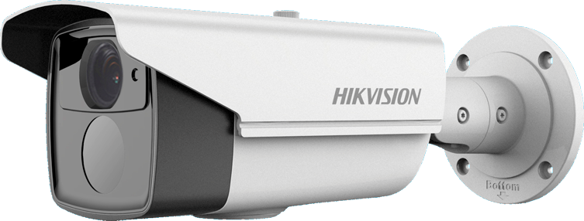
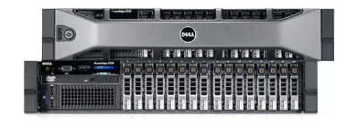
System Design, Sales & Install
Servers
Desktop Workstations
Laptops
Networking
Wireless Access Point
Infrastructures
Data Wiring
Security Camera’s

Slide 13
Referral Program
Refer a Friend and You Win!
The very best compliment someone can give us is a referral. Did you know that SourceONE has a very aggressive referral program? Want more information on our referral program?
Ask us today!

Slide 14
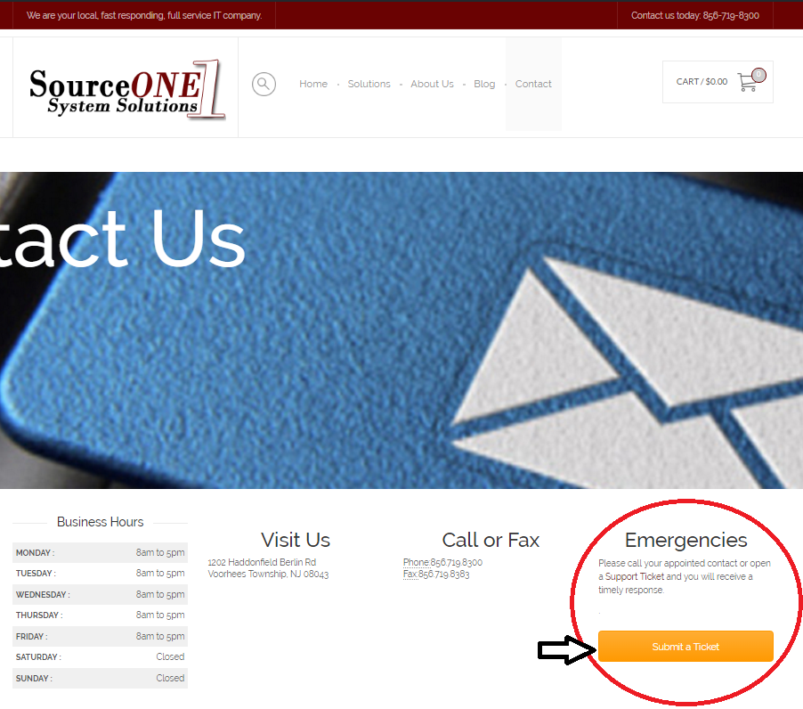
IT Help Desk
Having an IT emergency?
One thing you can do is call us direct so we can take your call and respond quickly.
Another way is to visit us on our website and click the link to submit a ticket. The response will be fast and you will be able to track the status and more.

Slide 15
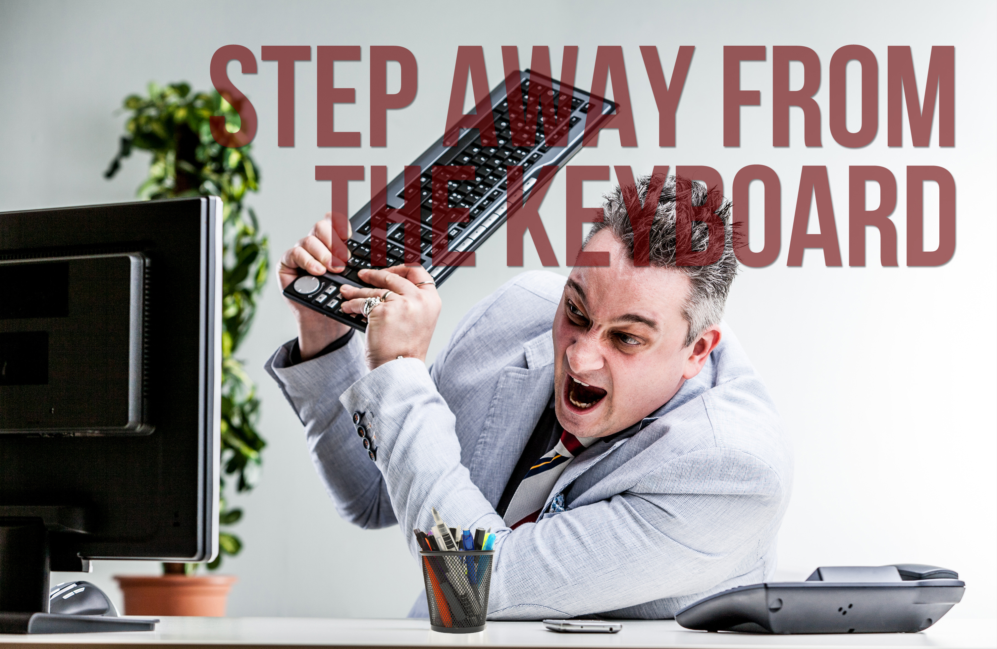

Slide 16
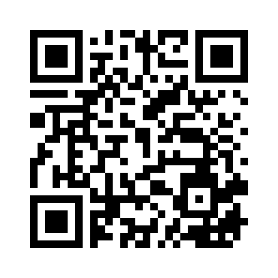
Social Media
Scan Our QR Code Here

